Slide 1

Riding the Sour Train: Building surtoget.no with Gleam

Slide 2
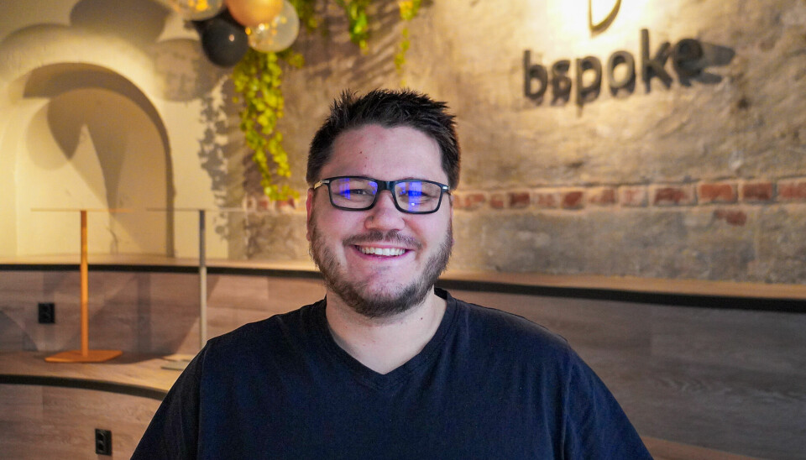

Developer/tech lead/architect
Worked with startups, healthcare, insurance, banking, transportation and stuff.
Bad at FE

Slide 3
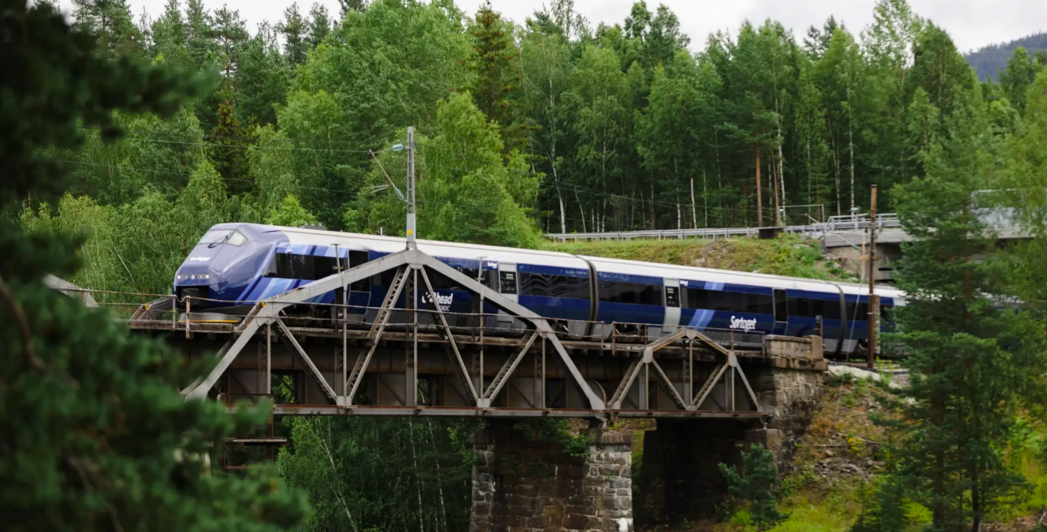

This talk
Notes:
Bettering some part of society? And doing so with gleam

Slide 4
This talk

Slide 5
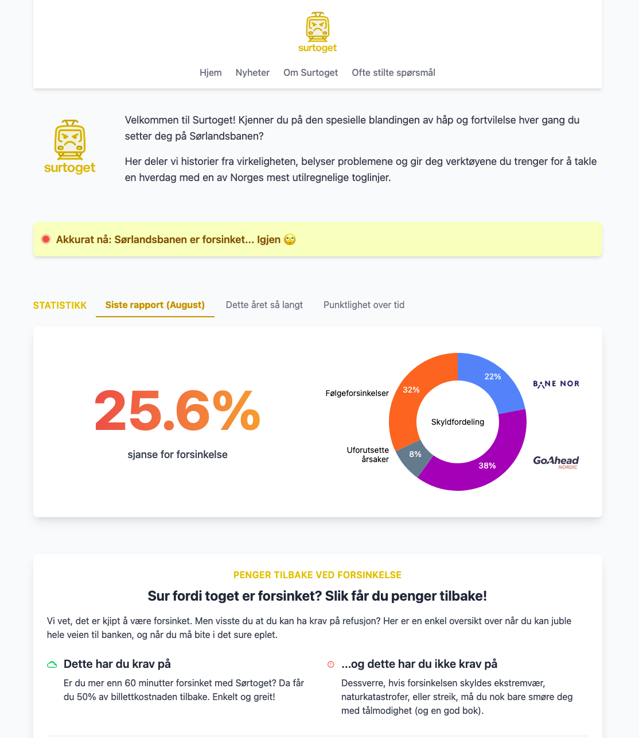

Slide 6



Slide 7
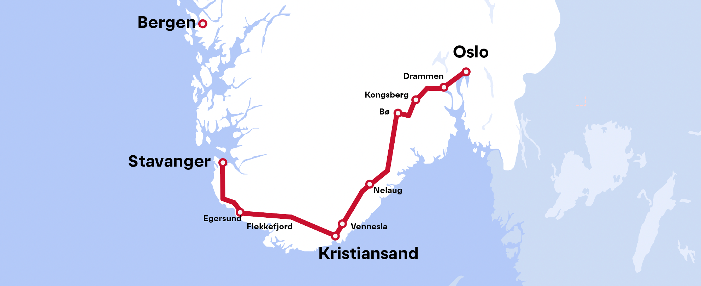
But what is a Sørlandsbanen anyway?
Lunde

Slide 8
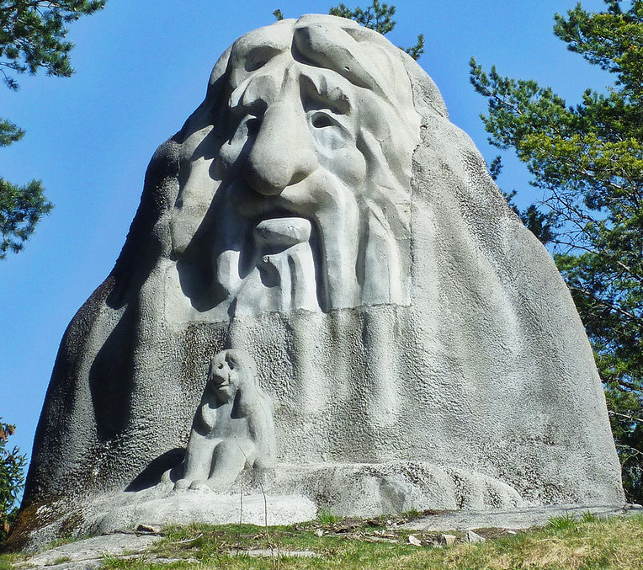
But what is a Sørlandsbanen anyway?
Lunde

Slide 9
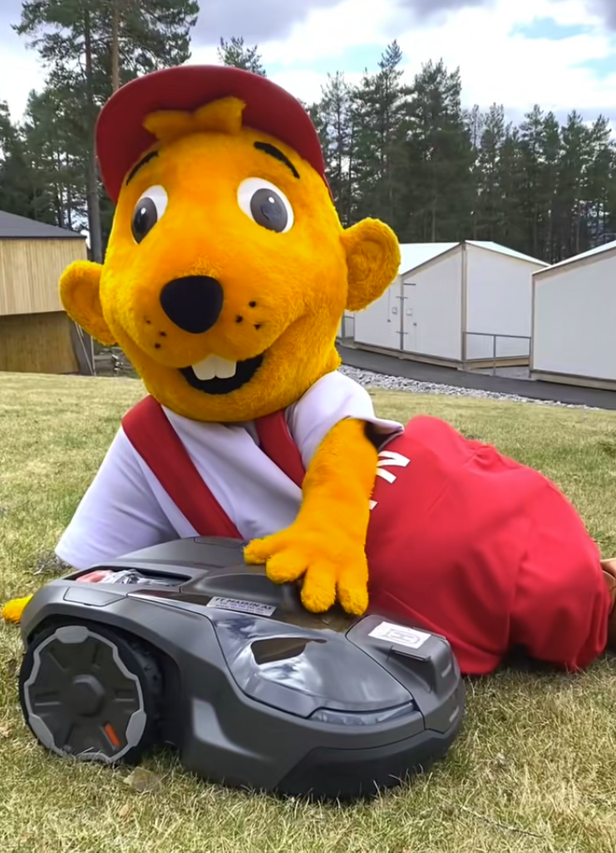
But what is a Sørlandsbanen anyway?
Lunde

Slide 10
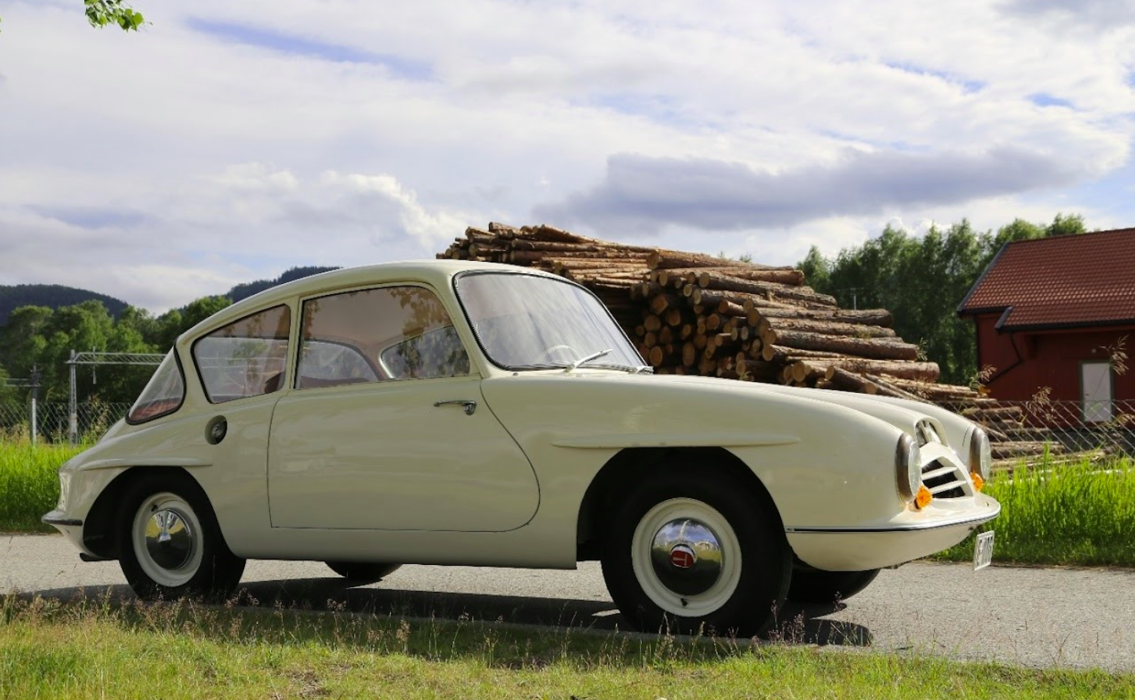
But what is a Sørlandsbanen anyway?
Lunde

Slide 11

But what is a Sørlandsbanen anyway?
Lunde

Slide 12

But what is a Sørlandsbanen anyway?
Lunde

Slide 13
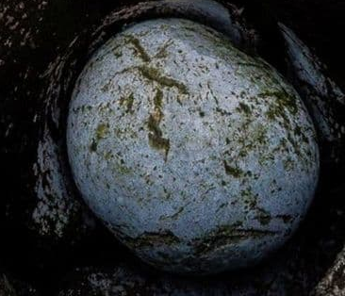
But what is a Sørlandsbanen anyway?
Lunde

Slide 14
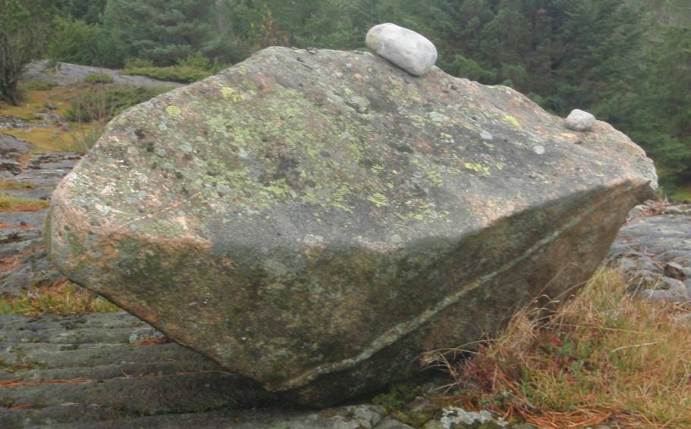
But what is a Sørlandsbanen anyway?
Lunde

Slide 15

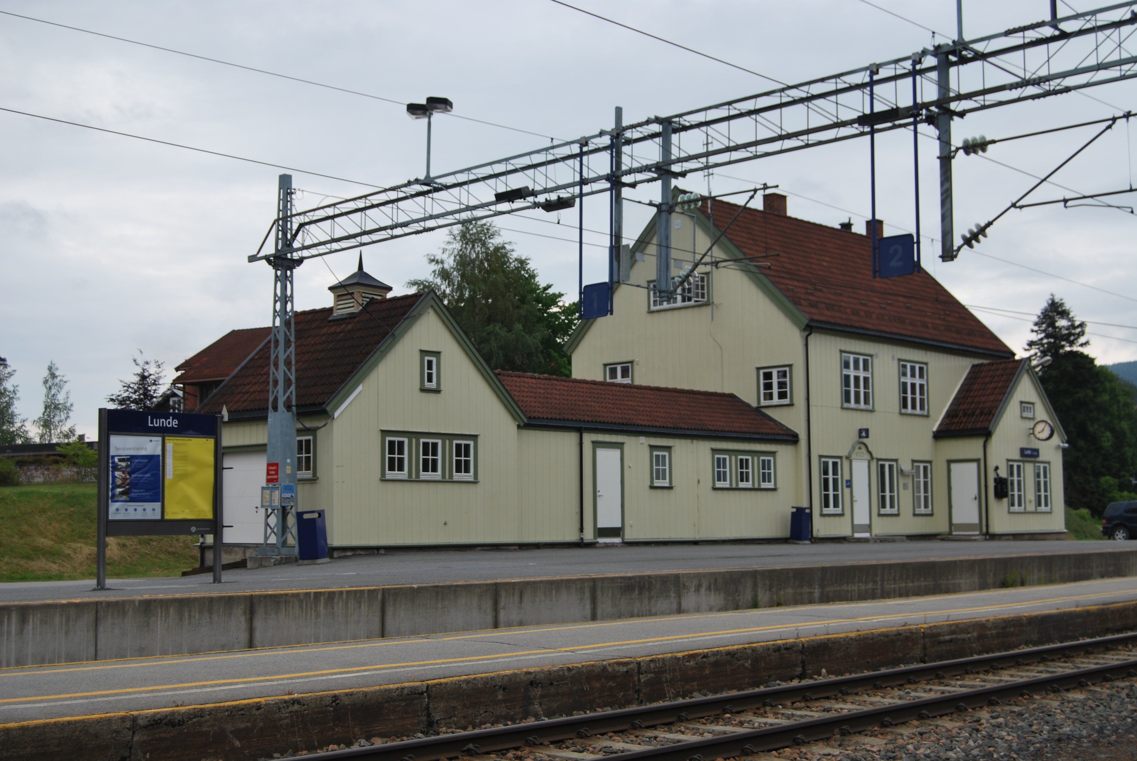
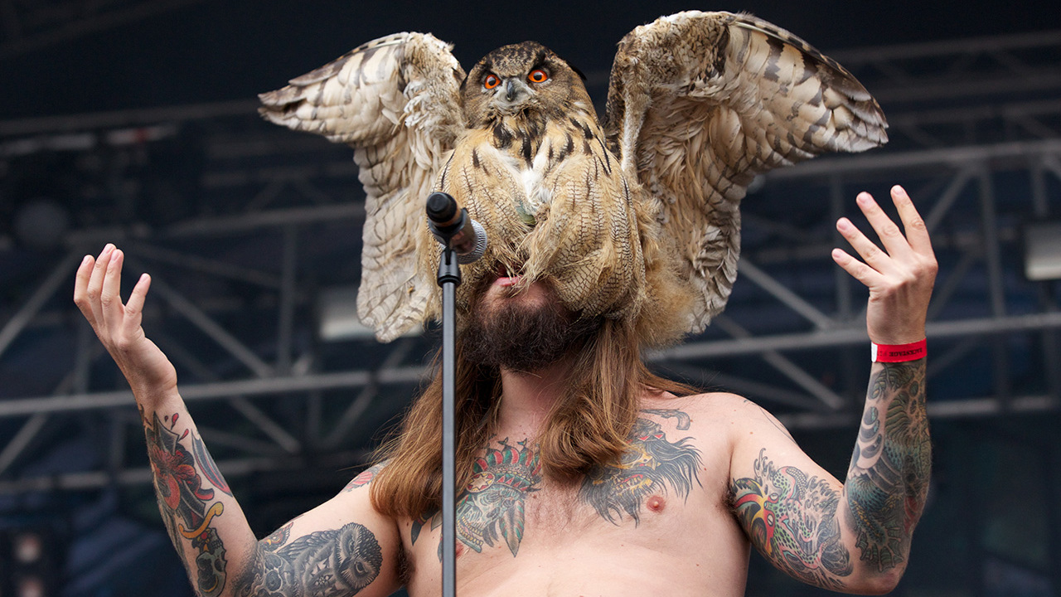

But what is a Sørlandsbanen anyway?
Lunde

Slide 16
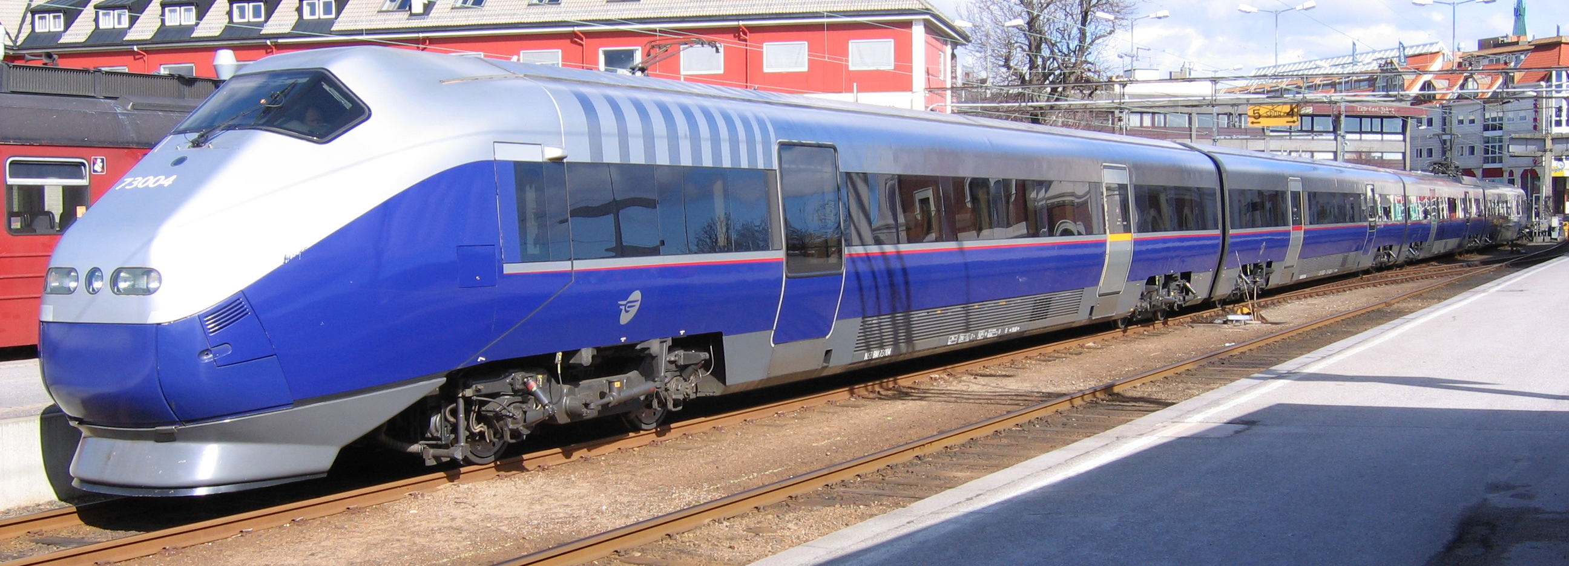
But what is a Sørlandsbanen anyway?
Strømmen
Type 73
Lunde
Notes:
I get phone calls from journalists along this entire line whenever there are serius delays

Slide 17
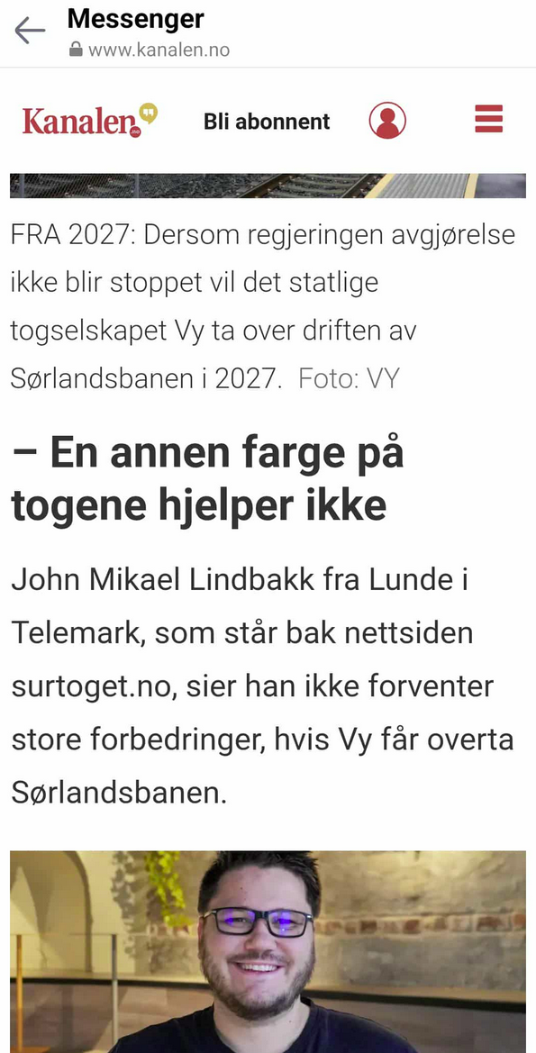
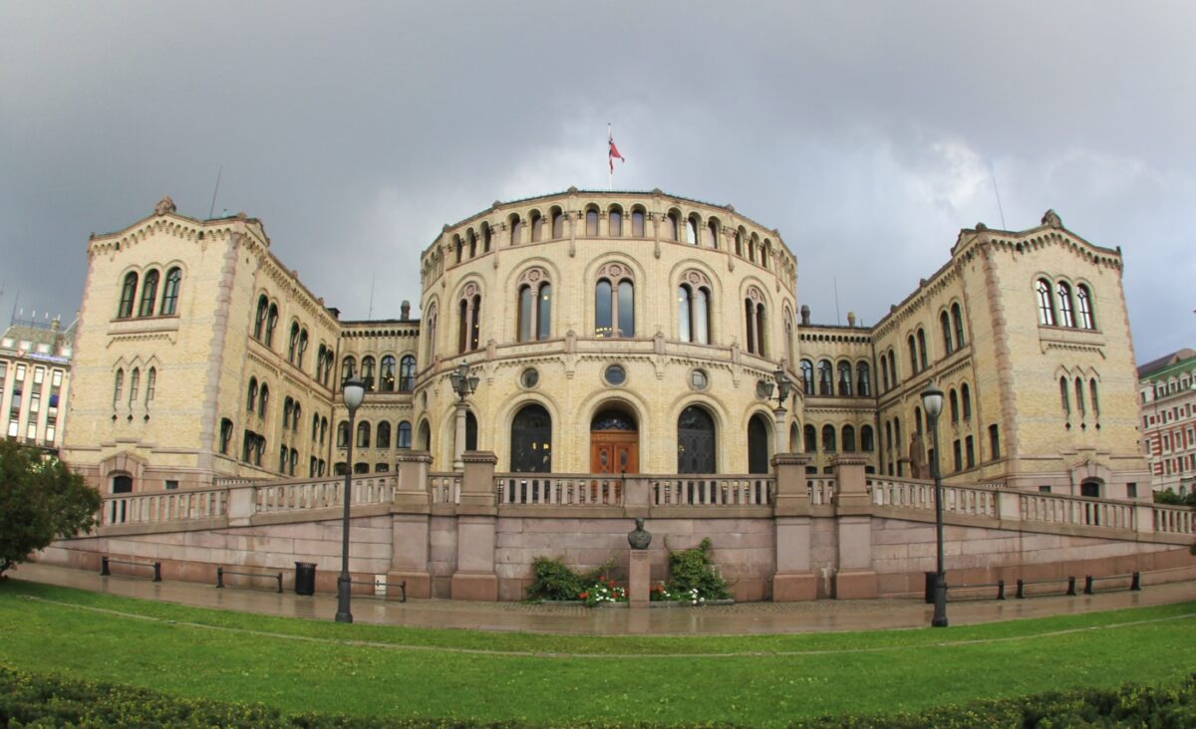

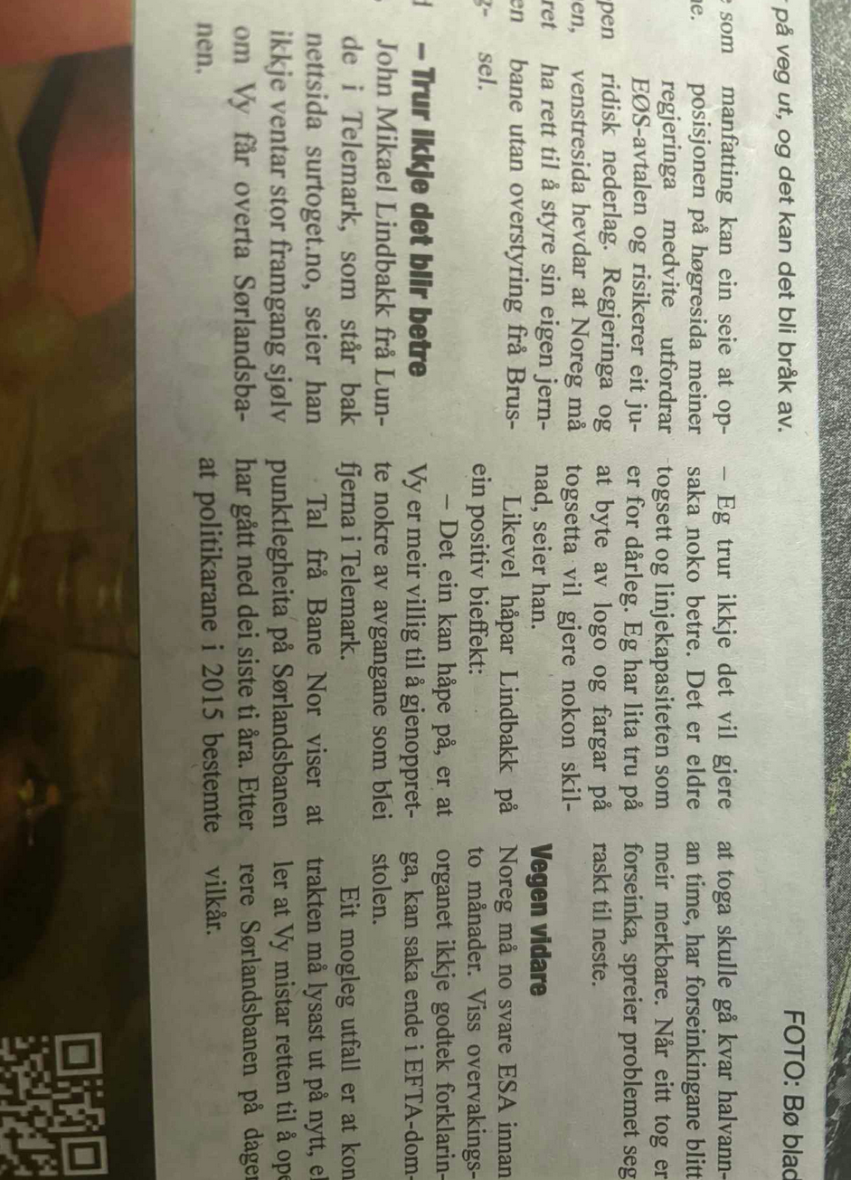
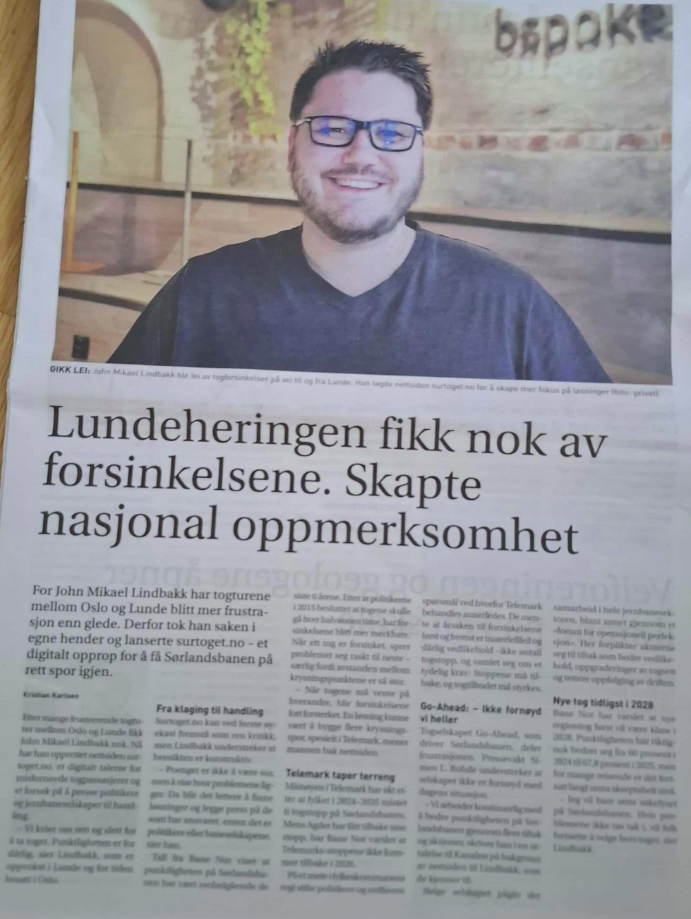
Notes:
Let’s talk impact

Slide 18


Slide 21
Developers are uniquely positioned to expose problems

Slide 22
Developers are uniquely positioned to expose problems

Slide 23
Typing

Slide 24
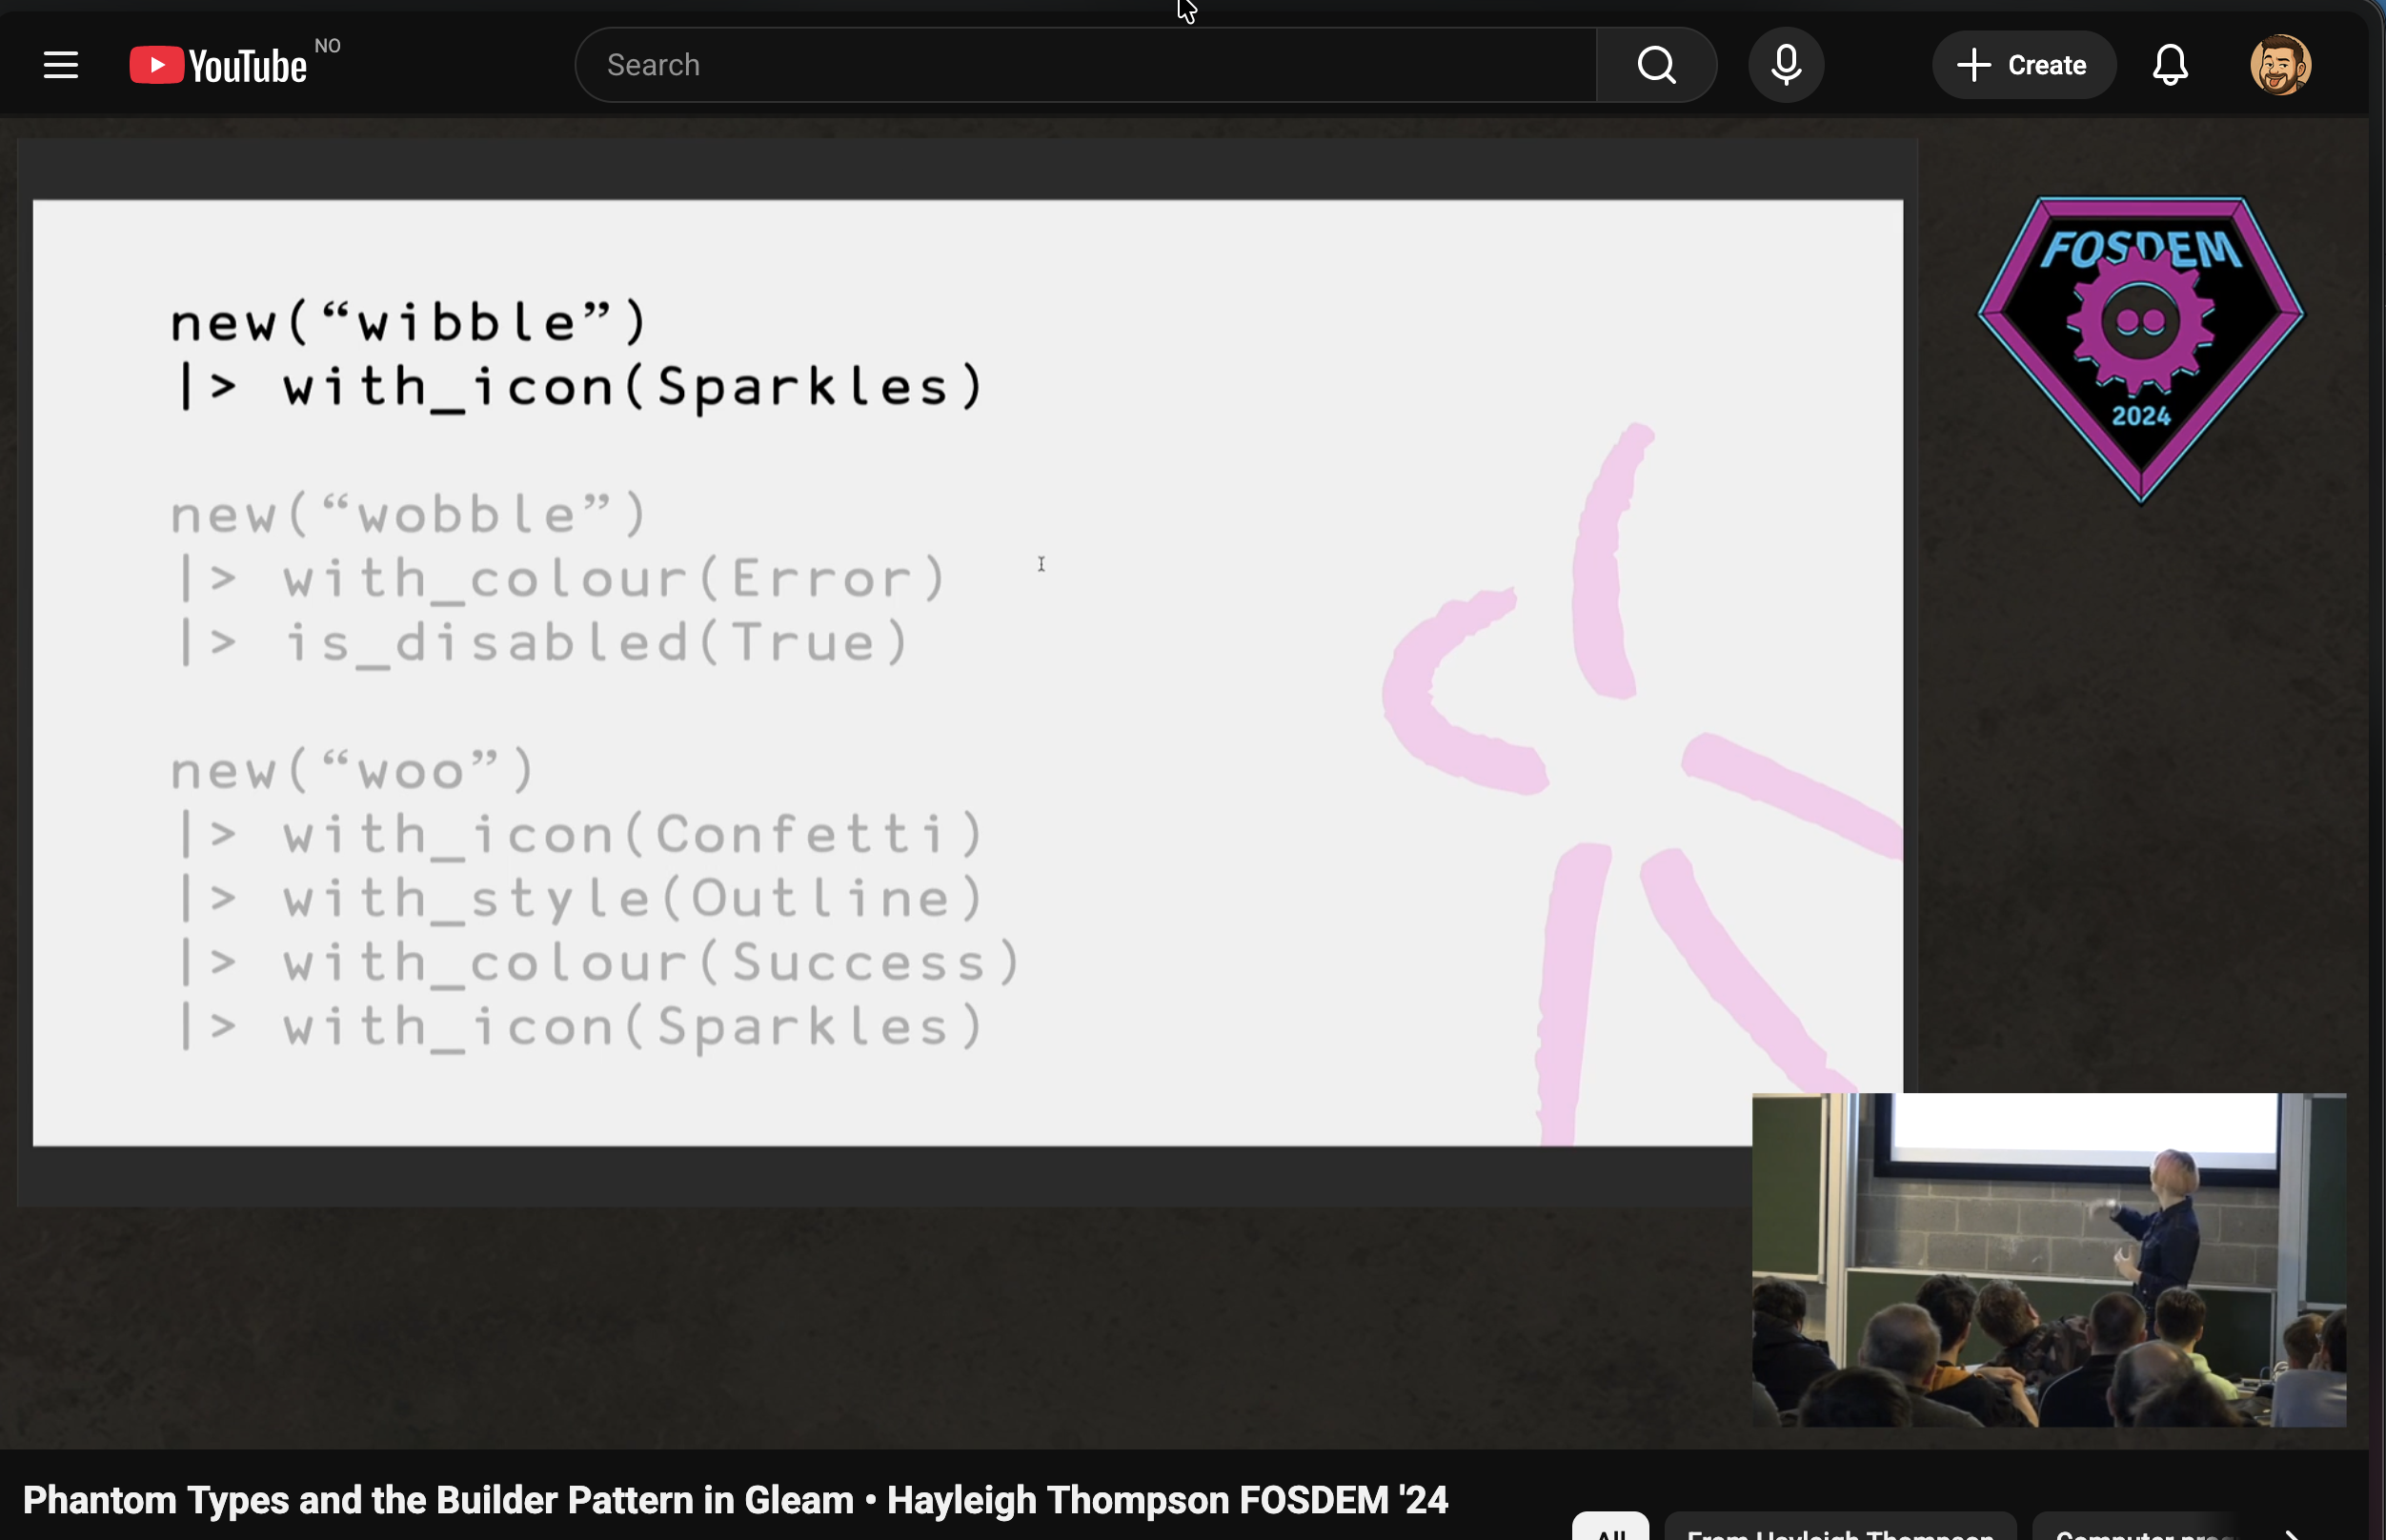
Link: https://www.youtube.com/watch?v=3lYHFctx2Ks

Slide 25
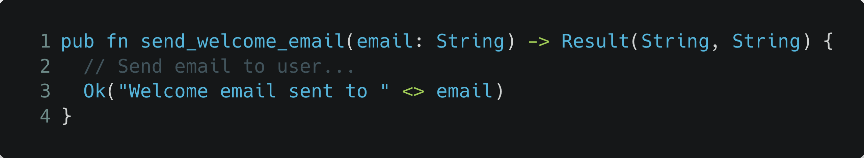

Slide 26
Is this a valid email?

Slide 27
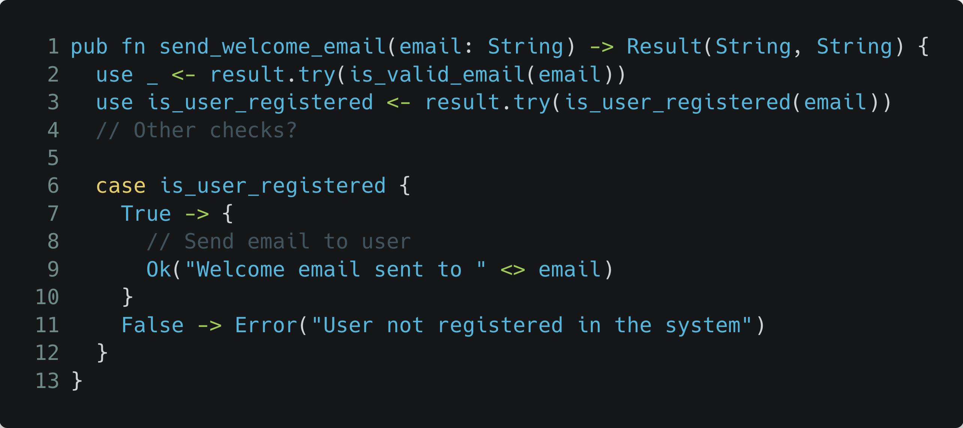

Slide 28
Dependencies and tight coupling

Slide 29
Validation failure
Communication failure

Slide 30
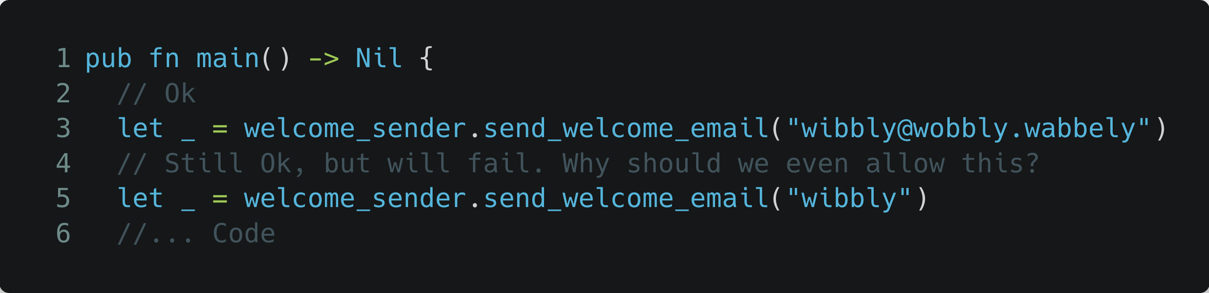

Slide 31
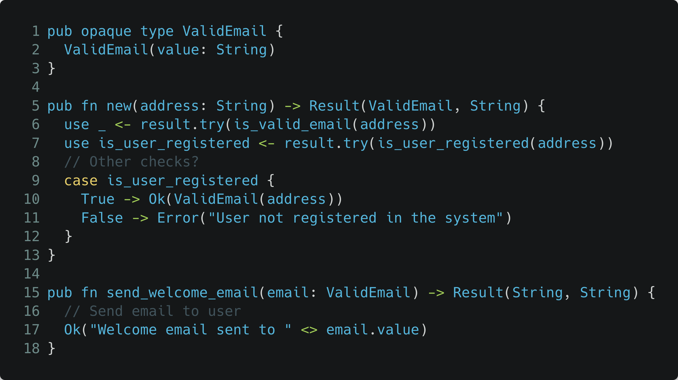

Slide 32
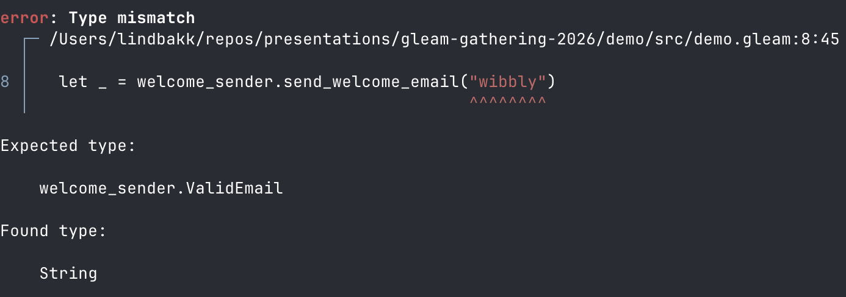

Slide 33
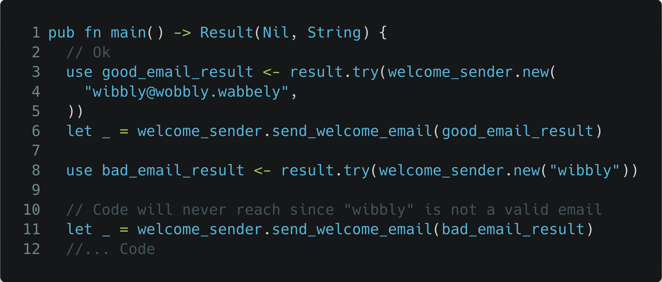

Slide 36

email_validator.gleam
welcome_sender.gleam

Slide 37
email_validator.gleam
welcome_sender.gleam
newsletter_sender.gleam
dark_pattern_sender.gleam

Slide 38
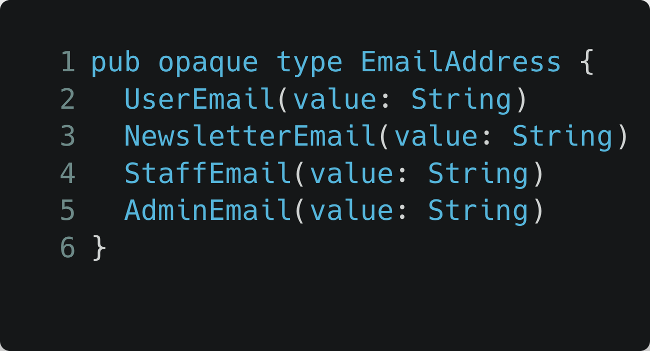
Web API
email_validator.gleam
Batch jobs
welcome_sender.gleam
Other?
newsletter_sender.gleam
dark_pattern_sender.gleam
All forced to validate!

Slide 39
Web API
“Make Illegal States Unrepre­sentable”
email_validator.gleam
- Yaron Minsky
Batch jobs
welcome_sender.gleam
Other?
newsletter_sender.gleam
dark_pattern_sender.gleam
All forced to validate!

Slide 40
Web API
“Make Illegal States Unrepre­sentable”
email_validator.gleam
- Yaron Minsky
Batch jobs
welcome_sender.gleam
Other?
newsletter_sender.gleam
dark_pattern_sender.gleam
All forced to validate!

Slide 41
What I want you to remember:
Use your technical skills to amplify your voice (for good)
Questions?
Use types to make illegal states a compile-time issue

Slide 42
What I want you to remember:
Use your technical skills to amplify your voice (for good)
Questions?
Use types to make illegal states a compile-time issue

